Slide 1
Verb 1
(page 01)

Slide 2

Use your pen to put words in a letter to someone

Slide 3
to write: /raɪt/ Use your pen to put words in a letter to someone
Ex:I wrote her several letters, but she didn’t reply.

Slide 4

- to look at written words and understand what they mean
- to find out information from books, newspapers etc

Slide 5
to read: /riːd/
- to look at written words and understand what they mean
- to find out information from books, newspapers etc
Ex: She picked up the letter and read it.

Slide 6
Use your pen to put words in a letter to someone

Slide 7
to write: /raɪt/ Use your pen to put words in a letter to someone
Ex:I wrote her several letters, but she didn’t reply.

Slide 8
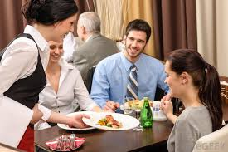
T
- to give someone food or drink, especially as part of a meal or in a restaurant, bar etc
- to help the customers in a shop, especially by bringing them the things that they want

Slide 9
to serve: /sɜːrv/
- to give someone food or drink, especially as part of a meal or in a restaurant, bar etc
- to help the customers in a shop, especially by bringing them the things that they want
Ex: The waiter was serving another table.

Slide 10
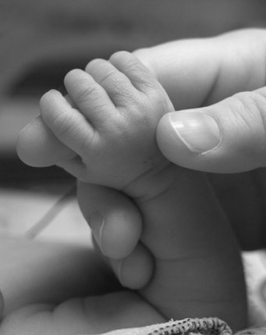
- to have something in your hand, hands, or arms
- to keep something to be used when it is needed

Slide 11
to hold: / həʊld /
- to have something in your hand, hands, or arms
- to keep something to be used when it is needed
Ex: He was holding a knife in one hand.

Slide 12

- to organize or make plans for something such as a meeting, party, or trip
- to put a group of things or people in a particular order or position

Slide 13
to arranging : /əˈreɪndʒ /
- to organize or make plans for something such as a meeting, party, or trip
- to put a group of things or people in a particular order or position
Ex: Ben arranged the flowers in a vase.

Slide 14

- if you water plants or the ground they are growing in, you pour water on them
- to give an animal water to drink

Slide 15
to water: /ˈwɔːtə /
- if you water plants or the ground they are growing in, you pour water on them
- to give an animal water to drink
Ex:
- Will you water my houseplants while I’m away?
- The garden needs watering daily.

Slide 16
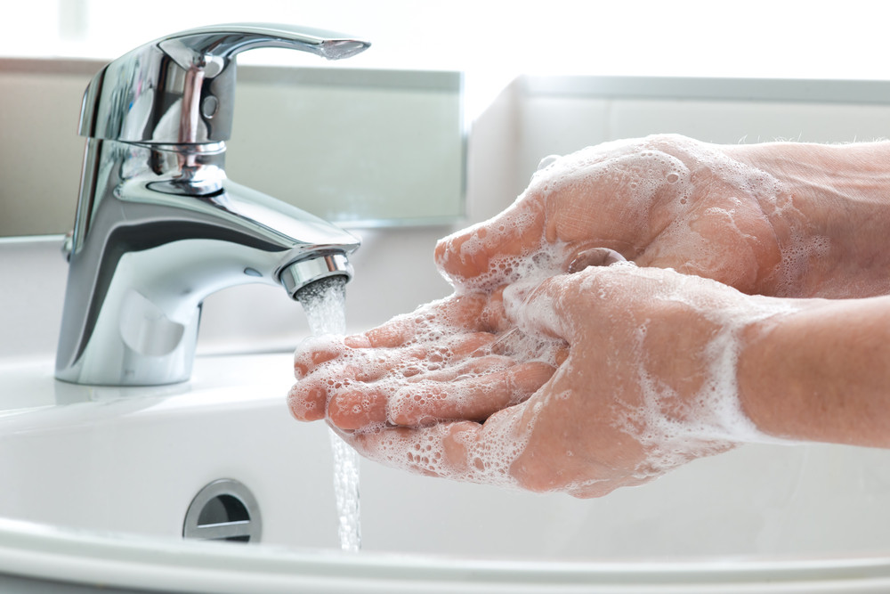
- to clean something using water and a type of soap
- to clean your body with soap and water

Slide 17
to wash: / wɑːʃ /
- to clean something using water and a type of soap
- to clean your body with soap and water
Ex: ‘It’s time we left, ’ Ian said, looking at his watch.

Slide 18

to turn your eyes towards something, so that you can see it

Slide 19
to look: /lʊk/
- to turn your eyes towards something, so that you can see it
Ex: ‘It’s time we left, ’ Ian said, looking at his watch.

Slide 20
to say things to someone as part of a conversation

Slide 21
to talk : /tɔːk/ to say things to someone as part of a conversation
Ex: She spent a long time talking to him.

Slide 22

to move forward by putting one foot in front of the other

Slide 23
to walk : / wɔːk / to move forward by putting one foot in front of the other
Ex: Doctors said he’d never walk again.

Slide 24
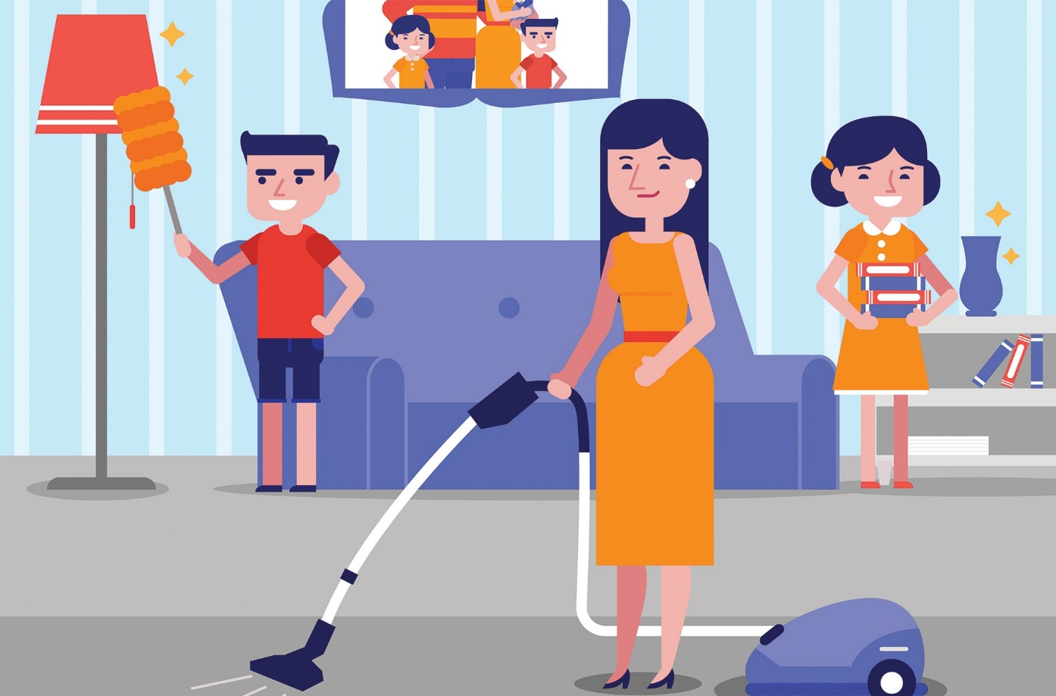
- to make a place look tidy
- bring order to; arrange neatly.

Slide 25
to tidy: /ˈtaɪdi/
- to make a place look tidy
- bring order to; arrange neatly.
Ex: Tidy your room!

Slide 26

- to clean something or make something smooth and tidy using a brush
- to remove something with a brush or with your hand

Slide 27
To brush: /brʌʃ/
- to clean something or make something smooth and tidy using a brush
- to remove something with a brush or with your hand
Ex:
- Don’t forget to brush your teeth.
- He brushed the tears from his eyes.

Slide 28
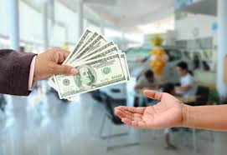
to give someone money for something you buy or for a service

Slide 29
to pay /peɪ/ to give someone money for something you buy or for a service
Ex: How would you like to pay?

Slide 30
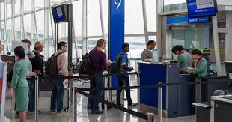
to get on a bus, plane, train etc in order to travel somewhere

Slide 31
to board: /bɔːd/ to get on a bus, plane, train etc in order to travel somewhere
Ex: Passengers were standing on the dock, waiting to board.

Slide 32
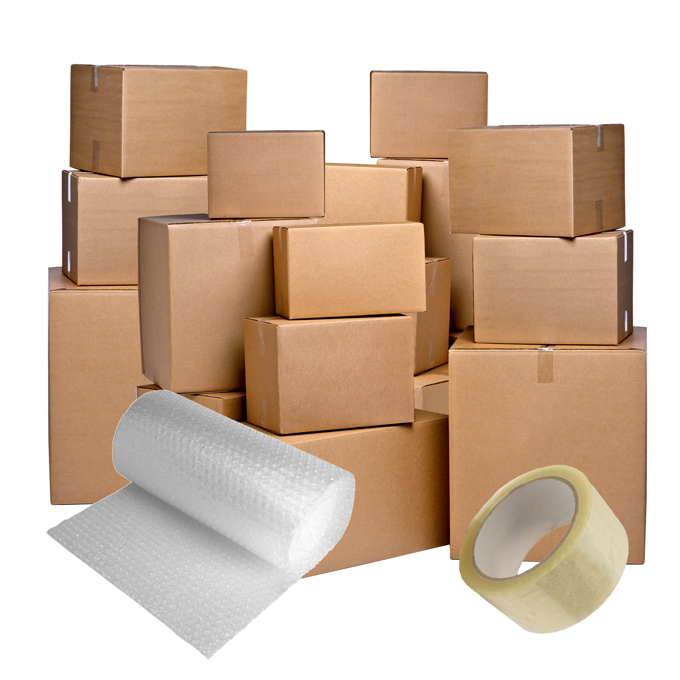
to put things into cases, bags etc ready for a trip somewhere.

Slide 33
To pack /pæk/:
- to put things into cases, bags etc ready for a trip somewhere.
Ex: You’d better pack your bags. We’re leaving in an hour

Slide 34

- to make a picture, design etc
- to describe someone or something in a particular way

Slide 35
paint /peɪnt/ :
- to make a picture, design etc
- to describe someone or something in a particular way
Ex: A white cross was painted on the door.

Slide 36
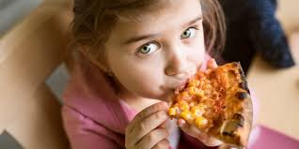
- to put food in your mouth and chew and swallow it
- to have a meal

Slide 37
to eat /iːt/
- to put food in your mouth and chew and swallow it
- to have a meal
Ex:
- A small girl was eating an ice cream.

Slide 38
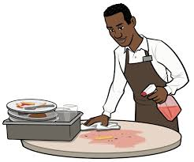
to make somewhere emptier or tidier by removing things from it

Slide 39
to clear: /raɪt/ to make somewhere emptier or tidier by removing things from it
Ex: Snowplows have been out clearing the roads.

Slide 40

to make a machine or piece of electrical equipment such as a television, engine, light etc stop operating by pushing a button, turning a key etc SYN switch off OPP turn on

Slide 41
to turn off: to make a machine or piece of electrical equipment such as a television, engine, light etc stop operating by pushing a button, turning a key etc SYN switch off OPP turn on
Ex: Don’t forget to turn the lights off when you leave.

Slide 42

- when children have free time, they do things that they enjoy, often with other people or with toys
- to take part or compete in a game or sport

Slide 43
to play: /plei/
- when children have free time, they do things that they enjoy, often with other people or with toys
- to take part or compete in a game or sport
Ex: Parents need to spend time just playing with their children.

Slide 44
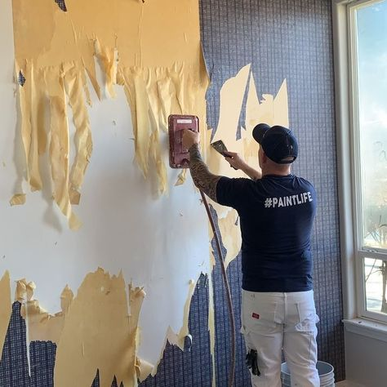
- to take something away from, out of, or off the place where it is
- to take off a piece of clothing

Slide 45
to removed : /rɪˈmuːv/
- to take something away from, out of, or off the place where it is
- to take off a piece of clothing
Ex: Reference books may not be removed from the library.

Slide 46
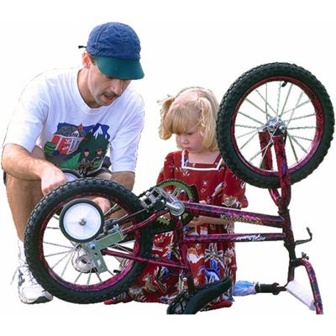
to fix something that is damaged, broken, split, or not working properly

Slide 47
To Repair/rɪˈpeə / to fix something that is damaged, broken, split, or not working properly
Ex: Where can I get my shoes repaired?

Slide 48
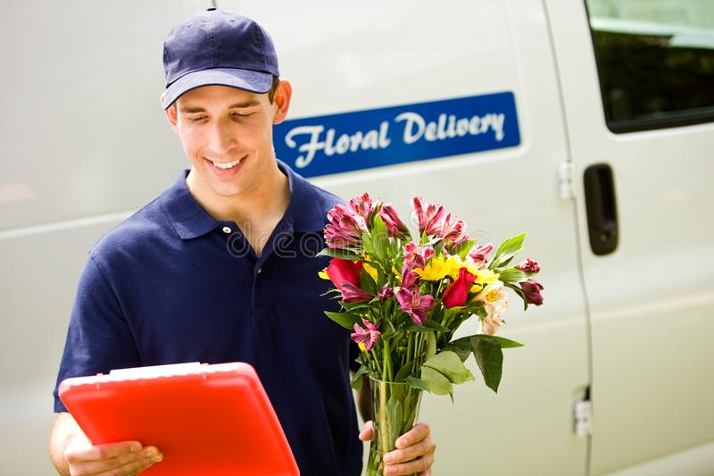
- to take goods, letters, packages etc to a particular place or person
- to do or provide the things you are expected to, because you are responsible for them or they are part of your job

Slide 49
to deliver: /dɪˈlɪvə/
- to take goods, letters, packages etc to a particular place or person
- to do or provide the things you are expected to, because you are responsible for them or they are part of your job
Ex: I’m having some flowers delivered for her birthday

Slide 50

- to change from one place or position to another, or to make something do this
- if a person or company moves, or if you move them, they go to live or work in a different place

Slide 51
to move: / muːv /
- to change from one place or position to another, or to make something do this
- if a person or company moves, or if you move them, they go to live or work in a different place
Ex: Please keep the doors closed while the train is moving.

Slide 52
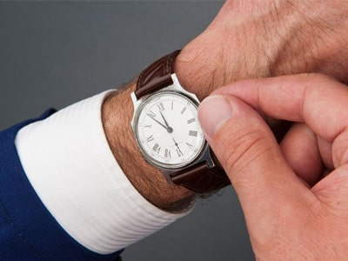
- to gradually become familiar with a new situation SYN adapt
- if you … something you are wearing, you move it slightly so that it is neater, more comfortable etc

Slide 53
to adjust: /əˈdʒʌst/
- to gradually become familiar with a new situation SYN adapt
- if you … something you are wearing, you move it slightly so that it is neater, more comfortable etc
Ex: It took a few seconds for her eyes to adjust to the darkness.

Slide 54
Thanks you

